Slide 1
File Systems
CS2200

Slide 2
File System Design
This is similar to the problems of a memory manager
Programmer abstraction vs Physical Reality

Slide 3
File Metadata
Name
Alias
Type
Owner
Access Rights
Creation Date
Modification Date
Size
Must be maintained somewhere by Operating System (File Manager)

Slide 4
Evolution of File Systems
Directory of Filenames
Top Directory containing Subdirectory and Filenames
Hierarchical Structure of Directories and Filenames

Slide 5
File Alias
Aliases
May be at actual file level
Linux: ln foo bar
Creates a new directory entry 'alias' with same status as 'original
i-node access rights hard links size creation time name
3193357 -rw------- 2 rama 80 Jan 23 18:30 bar
3193357 -rw------- 2 rama 80 Jan 23 18:30 foo
May be at level of names (same as shortcuts)
Linux: ln –s fox box
Creates a link entry named bar which contains foo
i-node access rights hard links size creation time name
3193495 lrwxrwxrwx 1 rama 3 Jan 23 18:52 box -> fox
3193357 -rw------- 1 rama 80 Jan 23 18:30 fox

Slide 6
Unix Commands
Unix command | Semantics | Elaboration
touch <name> | Create a file with the name <name> | Creates a zero byte file with the name <name> and a creation time equal to the current wall clock time
mkdir <sub-dir> | Create a sub-directory <sub-dir> | The user must have write privilege to the current working directory (if <sub-dir> is a relative name) to be able to successfully execute this command
rm <name> | Remove (or delete) the file named <name> | Only the owner of the file (and/or superuser) can delete a file
rmdir <sub-dir> | Remove (or delete) the sub-directory named <sub-dir> | Only the owner of the <sub-dir> (and/or the superuse) can remove the named sub-directory
ln –s <orig> <new> | Create a name <new> and make it symbolically equivalent to the file <orig> | This is name equivalence only; so if the file <orig> is deleted, the storage associated with <orig> is reclaimed, and hence <new> will be a dangling reference to a non-existent file
ln <orig> <new> | Create a name <new> and make it physically equivalent to the file <orig> | Even if the file <orig> is deleted, the physical file remains accessible via the name <new>
chmod <rights> <name> | Change the access rights for the file <name> as specified in the mask <rights> | Only the owner of the file (and/or the superuser) can change the access rights
chown <user> <name> | Change the owner of the file <name> to be <user> | Only superuser can change the ownership of a file
chgrp <group> <name> | Change the group associated with the file <name> to be <group> | Only the owner of the file (and/or the superuser) can change the group associated with a file
cp <orig> <new> | Create a new file <new> that is a copy of the file <orig> | The copy is created in the same directory if <new> is a file name; if <new> is a directory name, then a copy with the same name <orig> is created in the directory <new>
mv <orig> <new> | Renames the file <orig> with the name <new> | Renaming happens in the same directory if <new> is a file name; if <new> is a directory name, then the file <orig> is moved into the directory <new> preserving its name <orig>
cat/more/less <name> | View the file contents

Slide 7
Design Considerations for File System
Some design constraints
Four components of latency in doing I/O operations to and from disk
Seek time to a specific cylinder
Rotational latency to get specific sector under read/write head of disk
Transfer time from/to disk controller buffer
DMA transfer from/to controller buffer to/from system memory

Slide 8
Issues in design
Some design constraints
Files are of arbitrary size
Files may be accessed sequentially or randomly
Files need to be allocated initially
Files need to be able to grow
Space should be used efficiently

Slide 9
Figures of Merit for Design
Fast sequential access
Fast random access
Ability to grow the file
Easy allocation of storage
Efficiency of space utilization on the disk

Slide 10
Design Options For Allocation
Contiguous allocation
Contiguous allocation with overflow
Linked allocation
File Allocation Table (FAT)
Indexed allocation
Multilevel indexed
Hybrid indexed

Slide 11
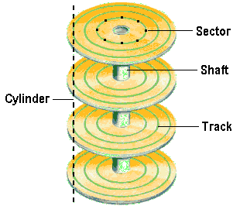
Disk Structure Review
Cylinder X- Track X from all surfaces (2 per platter)
Address is (Cylinder, Head, Sector)

Slide 12
New Way – Logical Block Addressing
Need to free io devices from exposing the mechanical parts of the drive
Make an abstraction that exists for other devices that do not have a layout like a disk drive
Each sector (block) on the disk receives a number beginning at Cylinder 0, Head 0, Sector 0 which has an LBA of 0 and goes to the last Cylinder, Head and Sector which would have the highest LBA for that drive. (For example, the LBA of the last block on a 540MB drive as 1,065,456 )
Since 512 byte sectors are small for today, OS may use clusters (a continguous allocation unit of several sectors, often 8 which gives 4K allocation unit size).
Note that some modern disks have 4K sector sizes and the OS may cluster these into 64K allocation units.

Slide 13
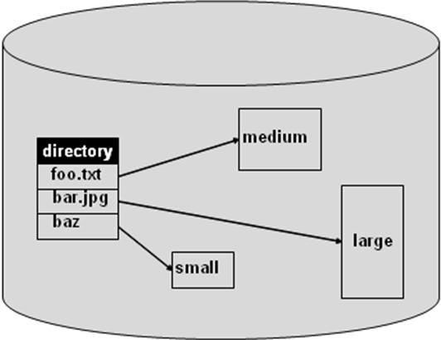
Contiguous Allocation
At file creation time, the file system allocates some amount of space (may depend on file type)
File cannot grow beyond that size
Fragmentation a problem
A disk with a directory that maps file name to a disk block address

Slide 14
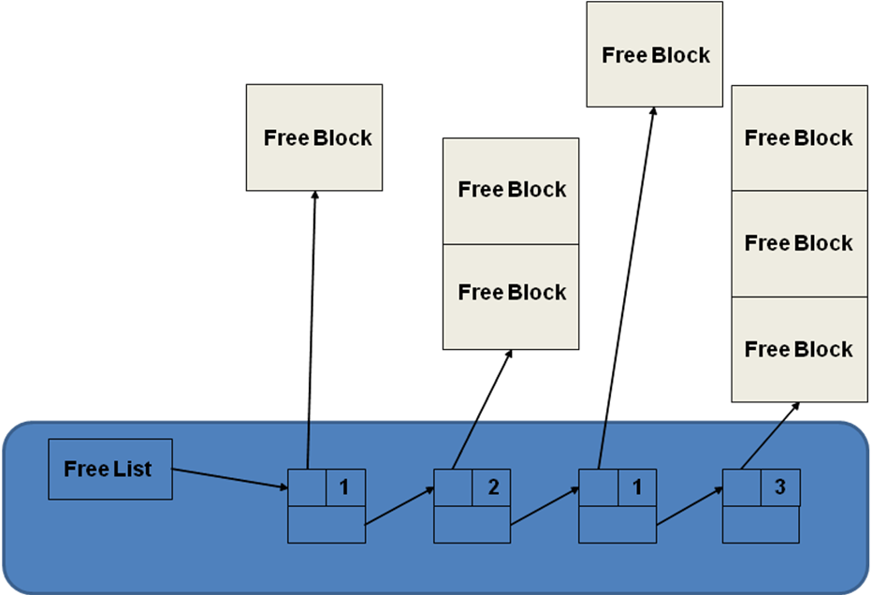
Contiguous Allocation
The file system maintains a free list
Allocation may be by first or best fit
Requires periodic compaction
External and internal fragmentation

Slide 15
Contiguous Allocation
Sequential and random access to file are efficient
Starting disk block is efficient
Problems:
file cannot grow in place beyond the size of the fixed partition
Internal and external fragmentation

Slide 16
Example of Contiguous Allocaiton
Suppose a disk drive has 256 bytes per sector, 128 sectors per track, 2 surfaces per platter, 10 platters and 10,000 cylinders on the disk.
How many cylinders should be allocated to store a 3 MB file?
Number of tracks in a cylinder = number of platters * number of surfaces per platter = 2 * 10 = 20
Size of track = number of sectors per track * size of sector = 128 * 256 = 2¹⁵ bytes
Capacity in one cylinder = number of tracks in 1 cylinder * size of tracks = 20 * 2¹⁵
No of cylinders for 3MB file=(3 * 2²⁰) / (20 * 2¹⁵) = 5

Slide 17
Internal Fragmentation
Suppose a disk drive has 256 bytes per sector, 128 sectors per track, 2 surfaces per platter, 10 platters and 10,000 cylinders on the disk.
How much internal fragmentation is caused by this allocation?
Internal fragmentation = 5 cylinders -3MB = 131072 bytes

Slide 18
Cont Alloc with Overflow
Modification of previous scheme to allow files to expand into a designated overflow area
Random access suffers due to overflow area
Despite limitations, this has been used extensively due to fast file access times

Slide 19
Linked List Allocation
Free list of sectors?
File name disk address
/foo 30
/bar 50
Name table

Slide 20
Linked Allocation
Files not stored contiguously
No compaction required
Sequential and random access poor
Susceptible to errors (any bug in the list maintenance code leads to a complete breakdown)

Slide 21
File Allocation Table (FAT)
Directory
FAT
0
0
0
Disk block
File name start index
30
1
70
0
/foo 30
.
.
50
1
-1
/bar 50
0
.
.
70
1
-1
Free/busy next
The linked list representing each individual file is maintained as an array

Slide 22
File Allocation Table (FAT)
Less chance for errors than linked allocation because FAT captures the linked list structure of the disk in a tabular data structure
Caching FAT in the memory leads to efficient allocation time
Problems:
Logical partitioning of a disk - FAT becomes big so clustering and partitioning may be necessary leading to other problems

Slide 23
Indexed Allocation
Essentially breaks up FAT into one data structure per file
Allocates an index disk block for each file called an i-node
Directory entries now point to the i-node for that file
Maintains free list as a bit vector (0 for free, 1 for busy)

Slide 24
Indexed Allocation
Data blocks
Directory
i-node for /foo
100
30
100
File name i-node address
201
/foo 30
201
/bar 50
i-node for /bar
50
99
99

Slide 25
Indexed Allocation
This method performs better than FAT for random access
Because the i-node aggregates all the disk block pointers into one concise data structure
Problem:
Since the i-node is a fixed size there is a maximum file size

Slide 26
Multilevel Indexed Allocation
This scheme fixes the limitation on the indexed allocation:
Makes the i-node point to index blocks which point to the files (first-level indirection)
This concept may be extended to two-level (and beyond) indirection
Problem: Accessing even a small file requires a lot of indirection

Slide 27
Multilevel Indexed Allocation
Data blocks
Directory
i-node for /foo
100
1st level
File name i-node address
30
40
40
100
45
201
201
/foo 30
45
299
299

Slide 28
Hybrid Indexed Allocation
Combine the previous two concepts
Two direct pointers for small files, but if the file size excides direct block size than,
One single indirect
One double indirect
One triple indirect

Slide 29
Hybrid Indexed Allocation
Data blocks
100
i-node for /foo
201
30
direct (100)
direct (201)
single indirect (40)
double indirect (45)
150
triple indirect
40
150
160
160
File
name
i-node
address
60
299
299
/foo 30
399
45
60
70
70
399
Directory

Slide 30
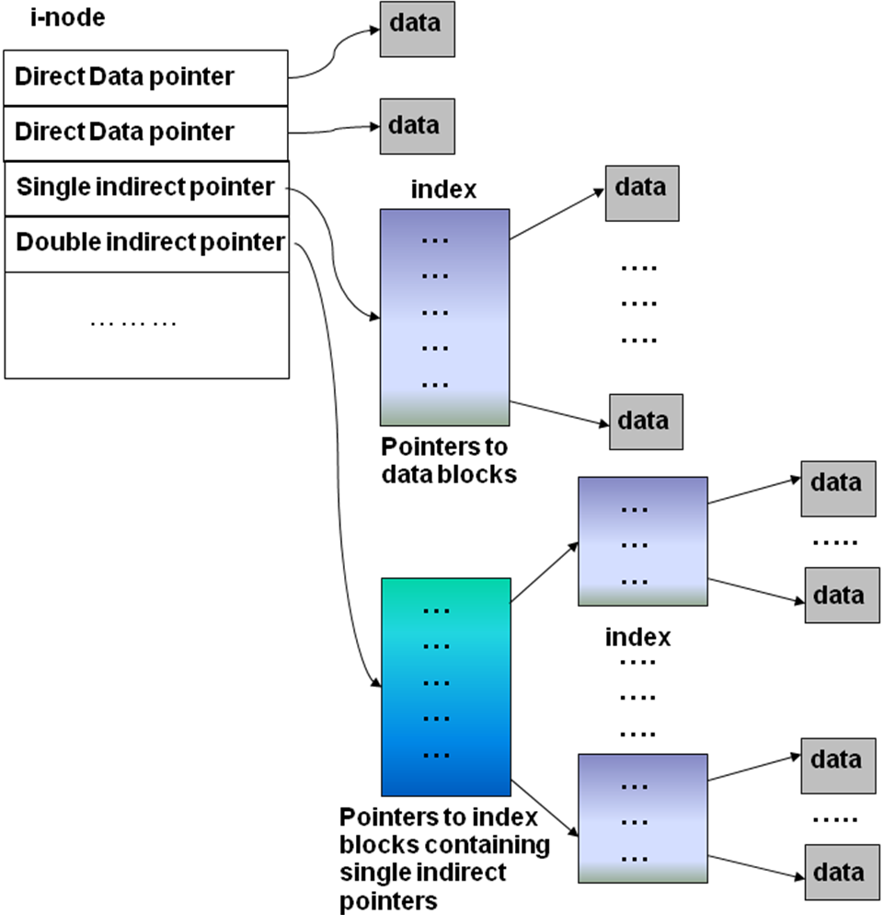
Hybrid Indexed Allocation

Slide 31
Allocation Strategy | File representation | Free list maintenance | Sequential Access | Random Access | File growth | Allocation Overhead | Space Efficiency
Contiguous | Contiguous blocks | complex | Very good | Very good | messy | Medium to high | Internal and external fragmentation
Contiguous With Overflow | Contiguous blocks for small files | complex | Very good for small files | Very good for small files | OK | Medium to high | Internal and external fragmentation
Linked List | Non- contiguous blocks | Bit vector | Good but dependent on seek time | Not good | Very good | Small to medium | Excellent
FAT | Non- contiguous blocks | FAT | Good but dependent on seek time | Good but dependent on seek time | Very good | Small | Excellent
Indexed | Non- contiguous blocks | Bit vector | Good but dependent on seek time | Good but dependent on seek time | limited | Small | Excellent
Multilevel Indexed | Non- contiguous blocks | Bit vector | Good but dependent on seek time | Good but dependent on seek time | Good | Small | Excellent
Hybrid | Non- contiguous blocks | Bit vector | Good but dependent on seek time | Good but dependent on seek time | Good | Small | Excellent

